Slide 1



IHE & SysML/MBSE – Moving from Doc to Model Centric
considering
Unity Consulting’s MBSE 2021.03.25 Webinar Perspectives
FHIR is a trademark of Health Level 7, International.

Slide 2
IHE TF Development Process – 20+ Years On!
Consider:
IHE’s TF Development process is rooted in life 20+ years ago (Document Centric)
To support more complex heterogeneous SES MDI environments … The IHE processes must align with state-of-the-art MedTech product development tools & processes supporting the Total Product Lifecycle
Recognizing there is a tension between … SysML / MBSE (OMG’s Systems Modeling Language & Model Based System Engineering) TDD / ATDD / BDD (Test / Acceptance Test / Behavior Driven Development – agile methods)
Safety Critical / “regulatory submission ready” IHE solutions must include MBSE

Slide 3
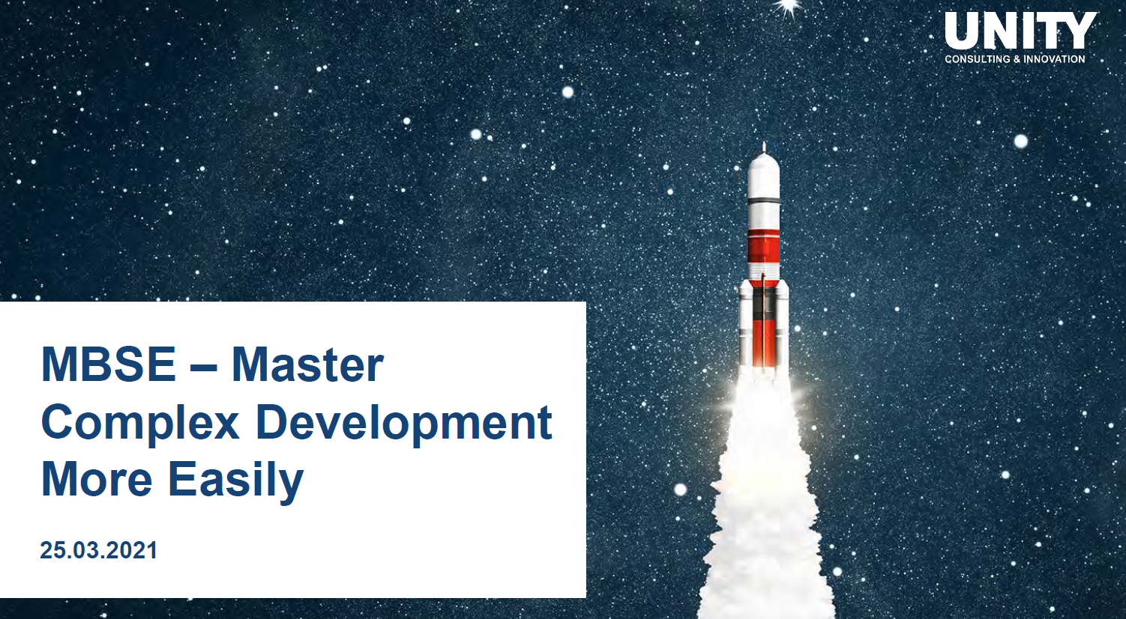
MBSE @ Unity: Serendipitously Timely Webinar!

Slide 4
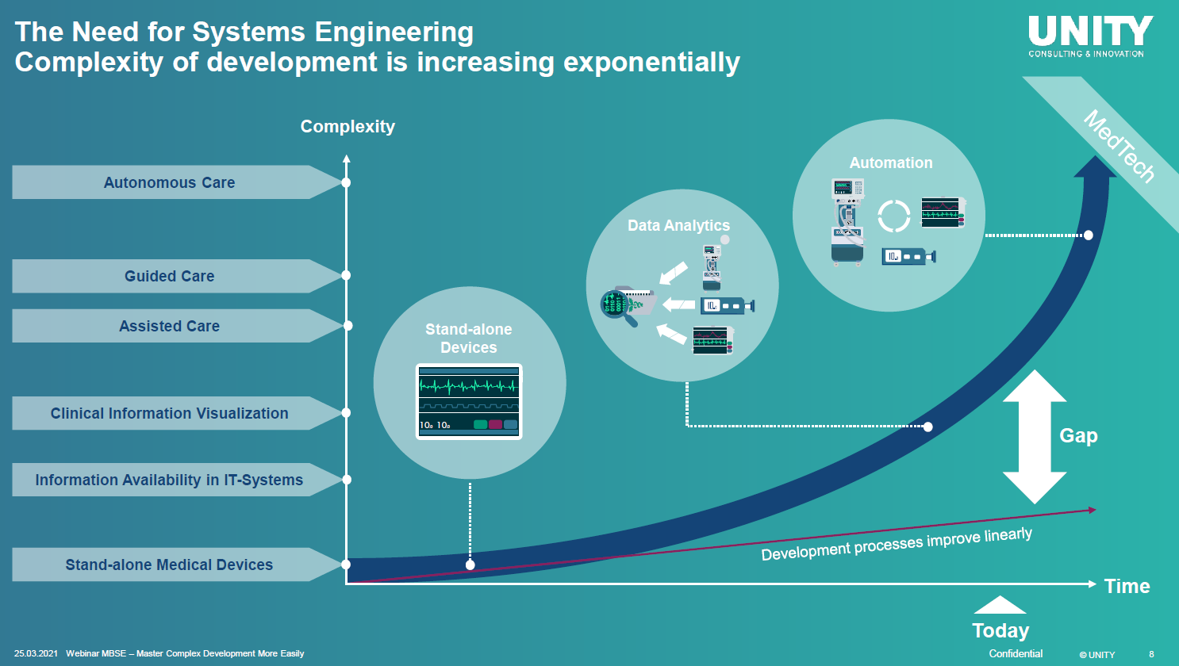
MBSE @ Unity: Complexity @ Autonomous Systems
Reality for SDC/SDPi Ecosystems
JHU/APL MDIRA Objective

Slide 5
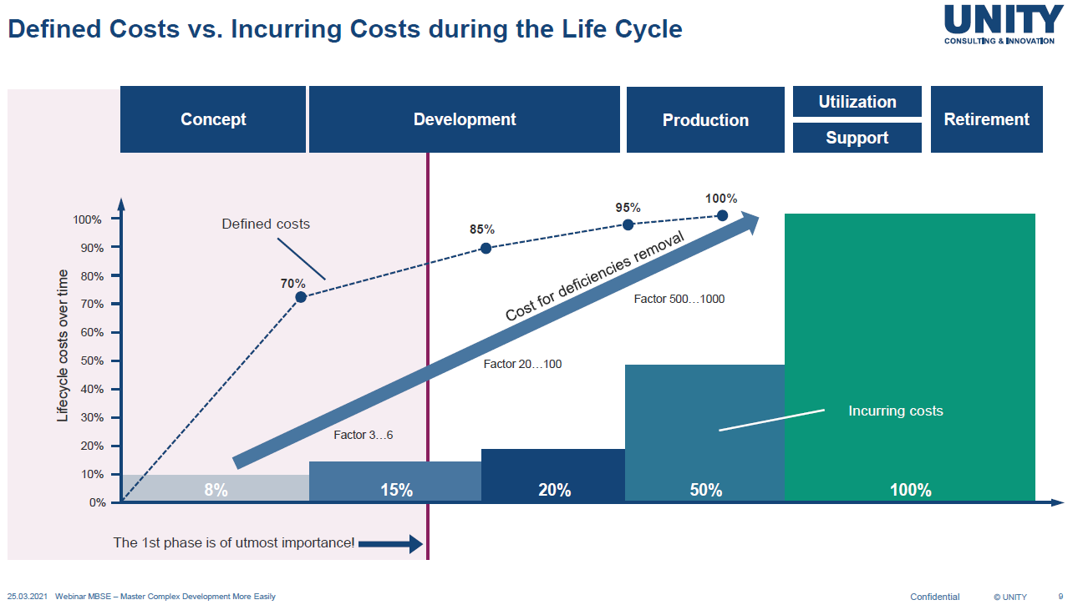
MBSE @ Unity: Address TPL $$$
To help MedTech developers adopt / implement / support IHE-based technologies …
TPL development costs must be directly impacted

Slide 6
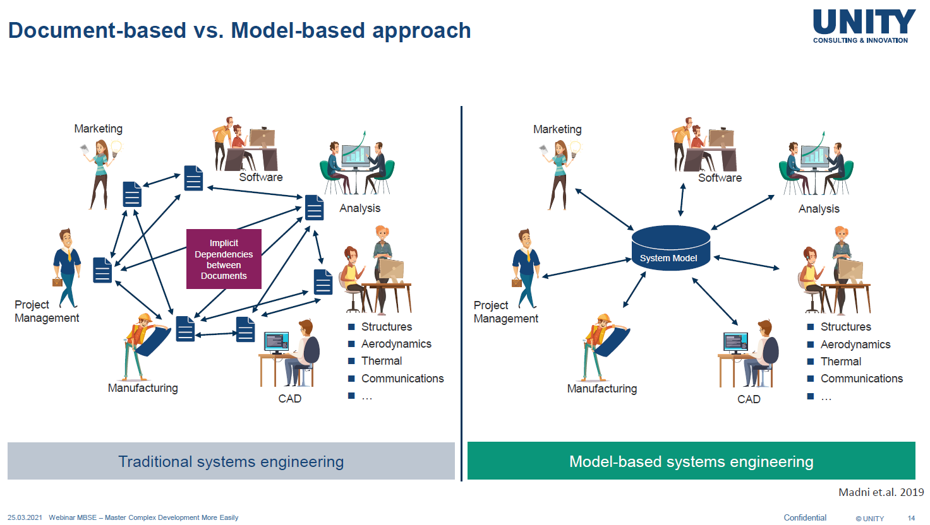
MBSE @ Unity: From Doc to Model-Based SE
IHE 20+ Year History …
IHE Model-based Source of Truth!

Slide 7
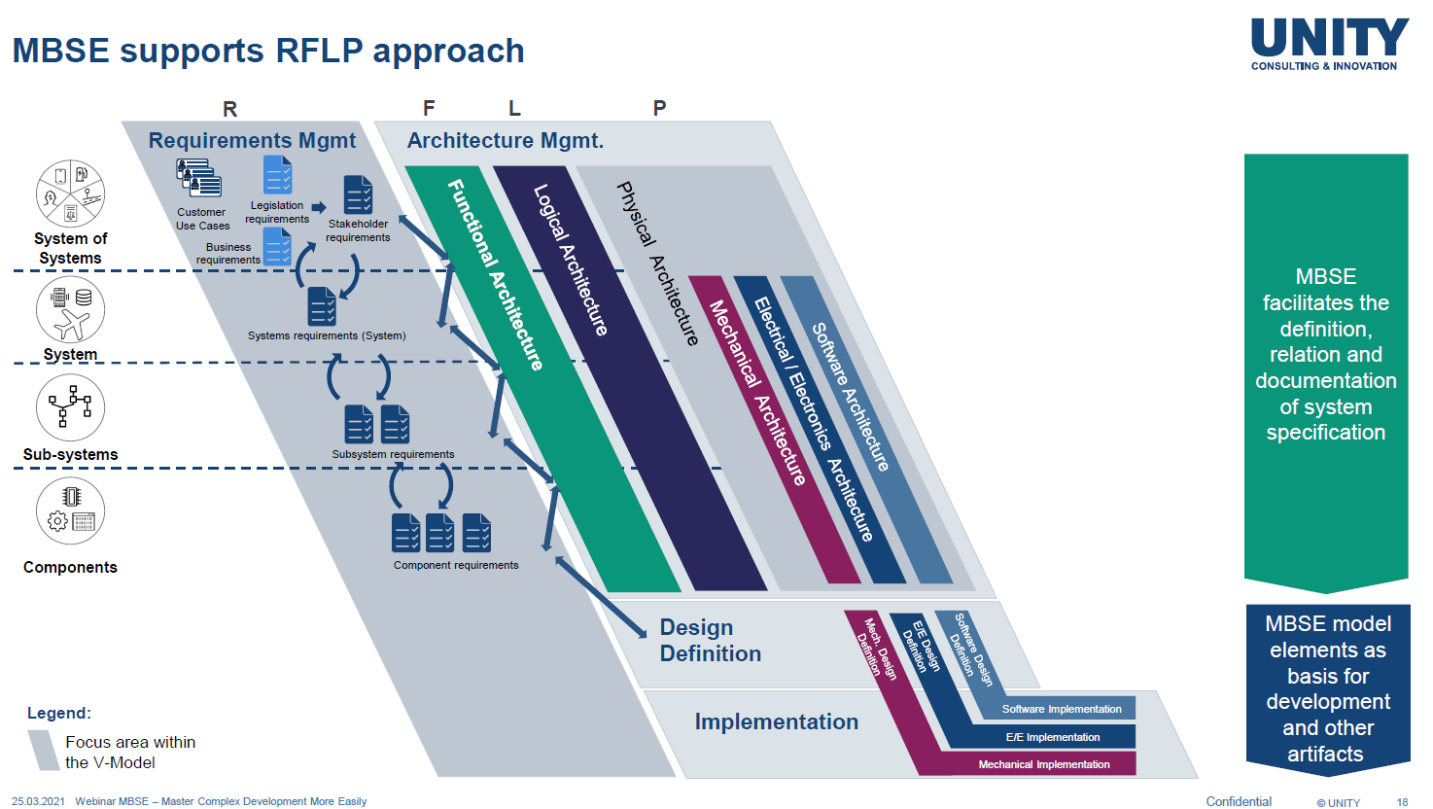
MBSE @ Unity: SysML/MBSE … starting @ RI Today
“Requirements Interoperability” (incl. ReqIF) is a primary focus for Gemnini SDC/SDPi+FHIR project today.

Slide 8
IHE TF Development Process – 20+ Years On!
Conclusions:
MBSE / SysML hits at the core value propositions for the IHE MedTech community
“Interoperable” MBSE / SysML is a “futures” proposition … but we can start today
Requirements Interoperability is a “safe” next step
“Model Repositories” as IHE TF Artifacts represent a “single COMPUTABLE source of truth”
MBSE can lower the cost-barrier-of-entry for the adoption / implementation of IHE-based solutions … starting with the development costs at the earliest stages of design
Unity: “The main function of SE is to facilitate communication!”
IHE TF Solutions are 100% about … COMMUNICATION!
Challenge:
MedTech Developers cannot / will not do the heavy lifting – research! – to get critical mass on Interoperable MBSE / SysML artifacts … Catalytic project support necessary!

